Slide 1


Stylish - Hack The Box Web Challenge

Slide 2
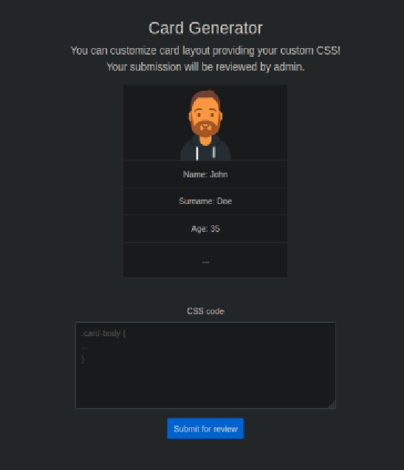




Overview of the web applications
Submit CSS
Users create custom stylesheets
Admin Review
Bot visits submission on localhost
Token System
Hidden approvalToken is used to approve the css
Approval
Unlocks comment section after approval

Slide 3





Source Code Analysis
CSP misconfiguration &
comment section vunerable to sql injection
Admin Bot
Visits http://127.0.0.1:1337/view/${submissionID}
Hidden Element
Token is named as approval token which is used by admin
Approval Path
Submission is approved using path
localhost /approve/ submissionid/approvaltoken

Slide 4





Plan of action
CSS injection
Leaking the Token Using CSS Injection
Security Bypass
Extract admin token from hidden elements
Goal
Unlock admin features to find
the final flag

Slide 5

Tried Approaches
Burp Suite
Nmap Scan
Captured traffic but no admin requests
Found login page but needed admin credentials

Slide 6








CSS Injection Attack & Token Capture System
using python code
CSS Payload
Submits malicious stylesheet to challenge, Used token characterset to trigger font loads only if certain characters were present
Flask Server
Listens on port 8080 for leaked characters
Token Assembly
Sorts 32 unique characters alphabetically
Character Collection
Logs each /leak/ request from admin bot

Slide 7








Exploiting The Flag
Flag Extraction
SQLmap dumps flag from database
SQL Injection
Vulnerable pagination parameter
Comment System Access
New features unlocked after approval
Token Utilization
Auto-approve via http://127.0.0.1:1337/approve/1/approvaltoken

Slide 8
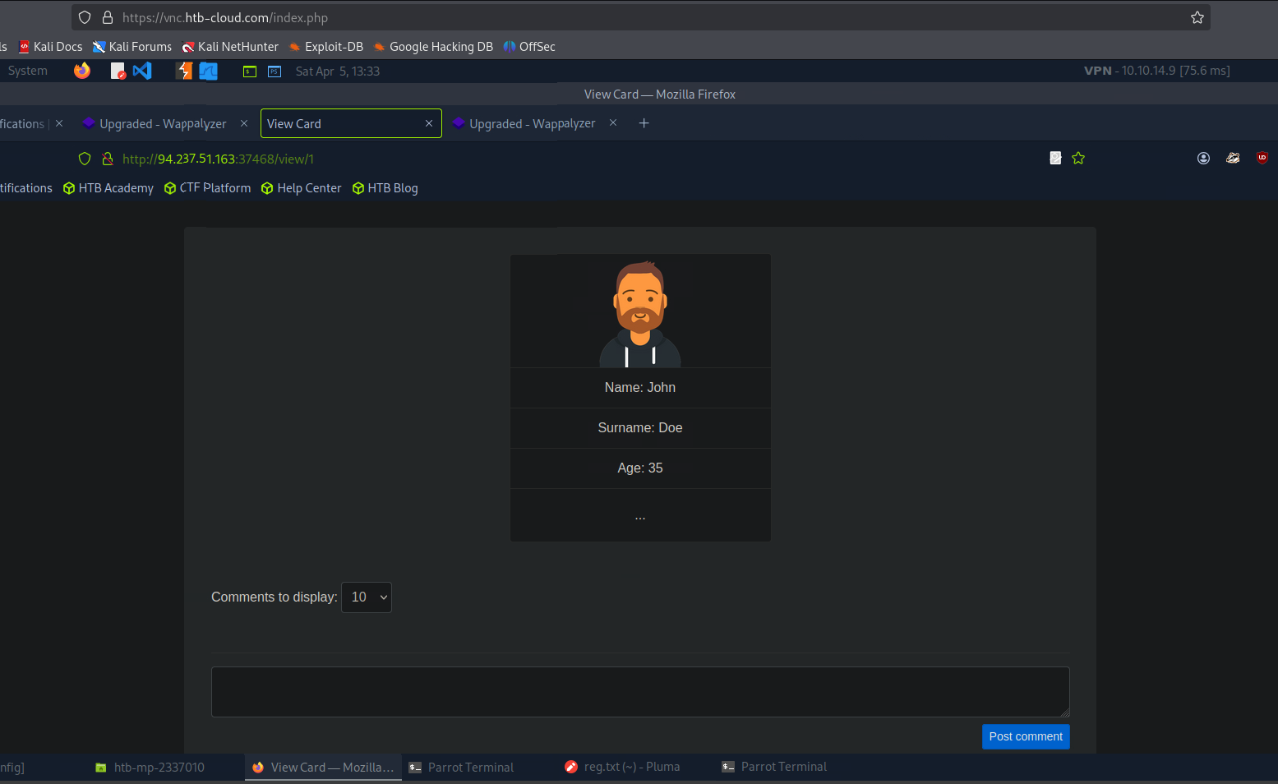
New features unlocked
after approval

Slide 9
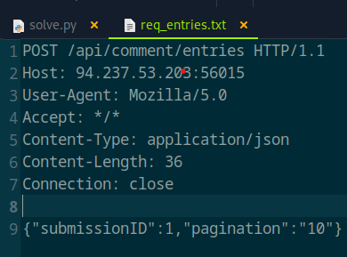
Exploiting SQL Injection in the Comments Section
Access Granted
Vulnerable Endpoint
Capture Vulnerable Request
Database Takeover
With the token captured, the comment system unlocked after approval. New attack surface exposed.
Injecting SQL commands through pagination parameter granted full database access.
Saved the SQL injection point to req_entries.txt after confirming the pagination parameter vulnerability.
sqlmap -r req_entries.txt --dbms=sqlite --level=2 --batch --tables

Slide 10
Final Step: Extracting the Flag with sqlmap
Launch Automated Exploitation
Identify the table
Extract the Flag
Successfully dumped the flag: HTB{Wh0_S41d_tH4t_c$$_sh0uld_b3_c0ns1d3r3d_s4Fe??!}
Executed sqlmap with targeted parameters:
Tool discovered the critical database table: flag_4154739d.
sqlmap -r req_entries.txt --dbms=sqlite --level=2 --batch --dump

Slide 11
